Slide 1
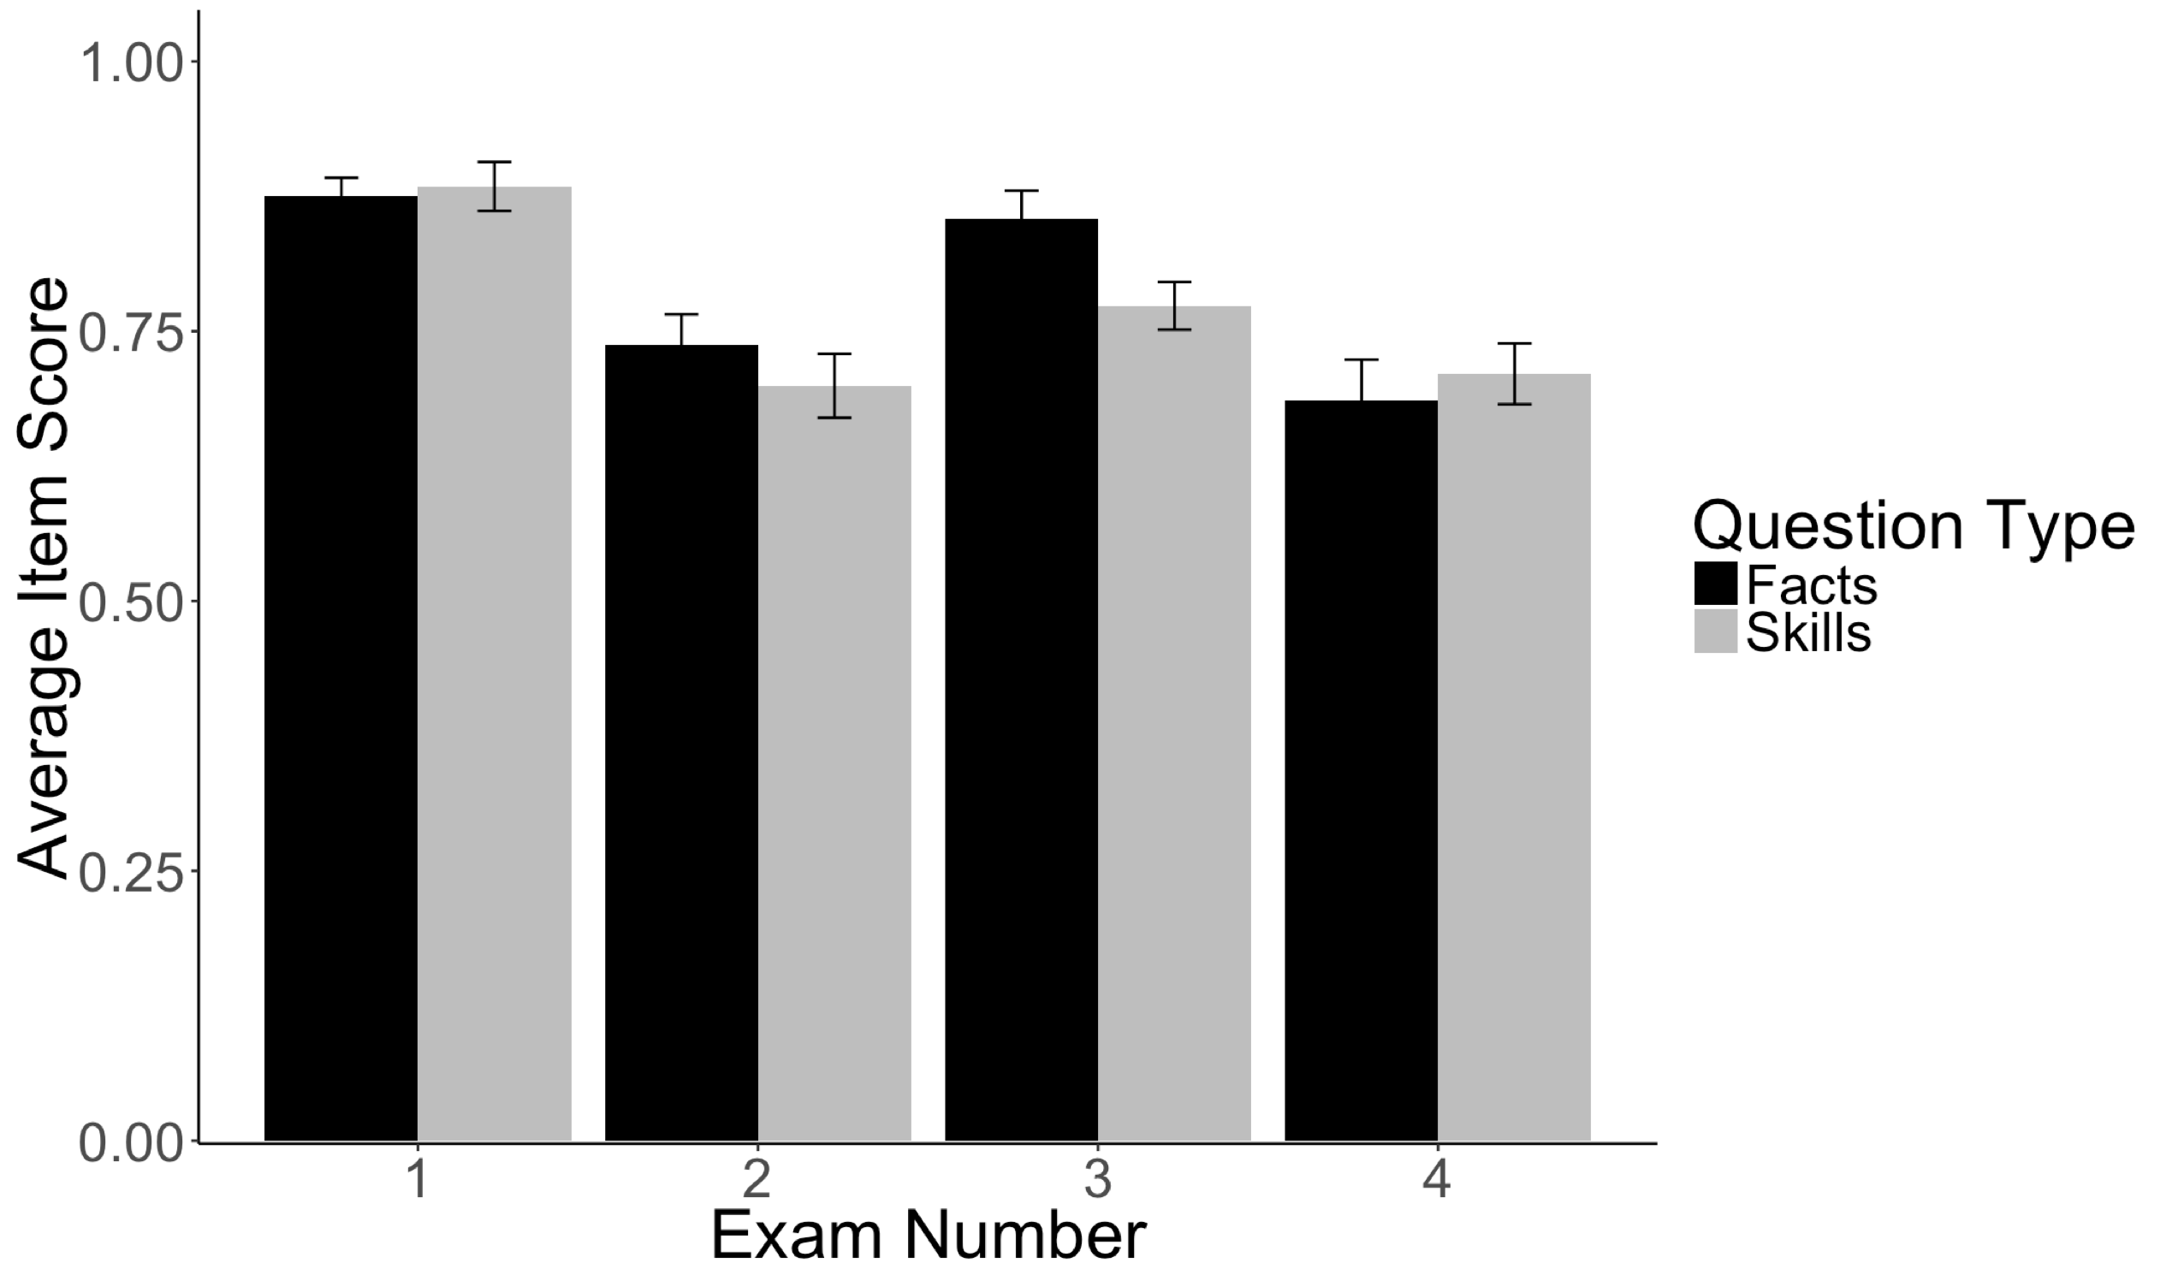
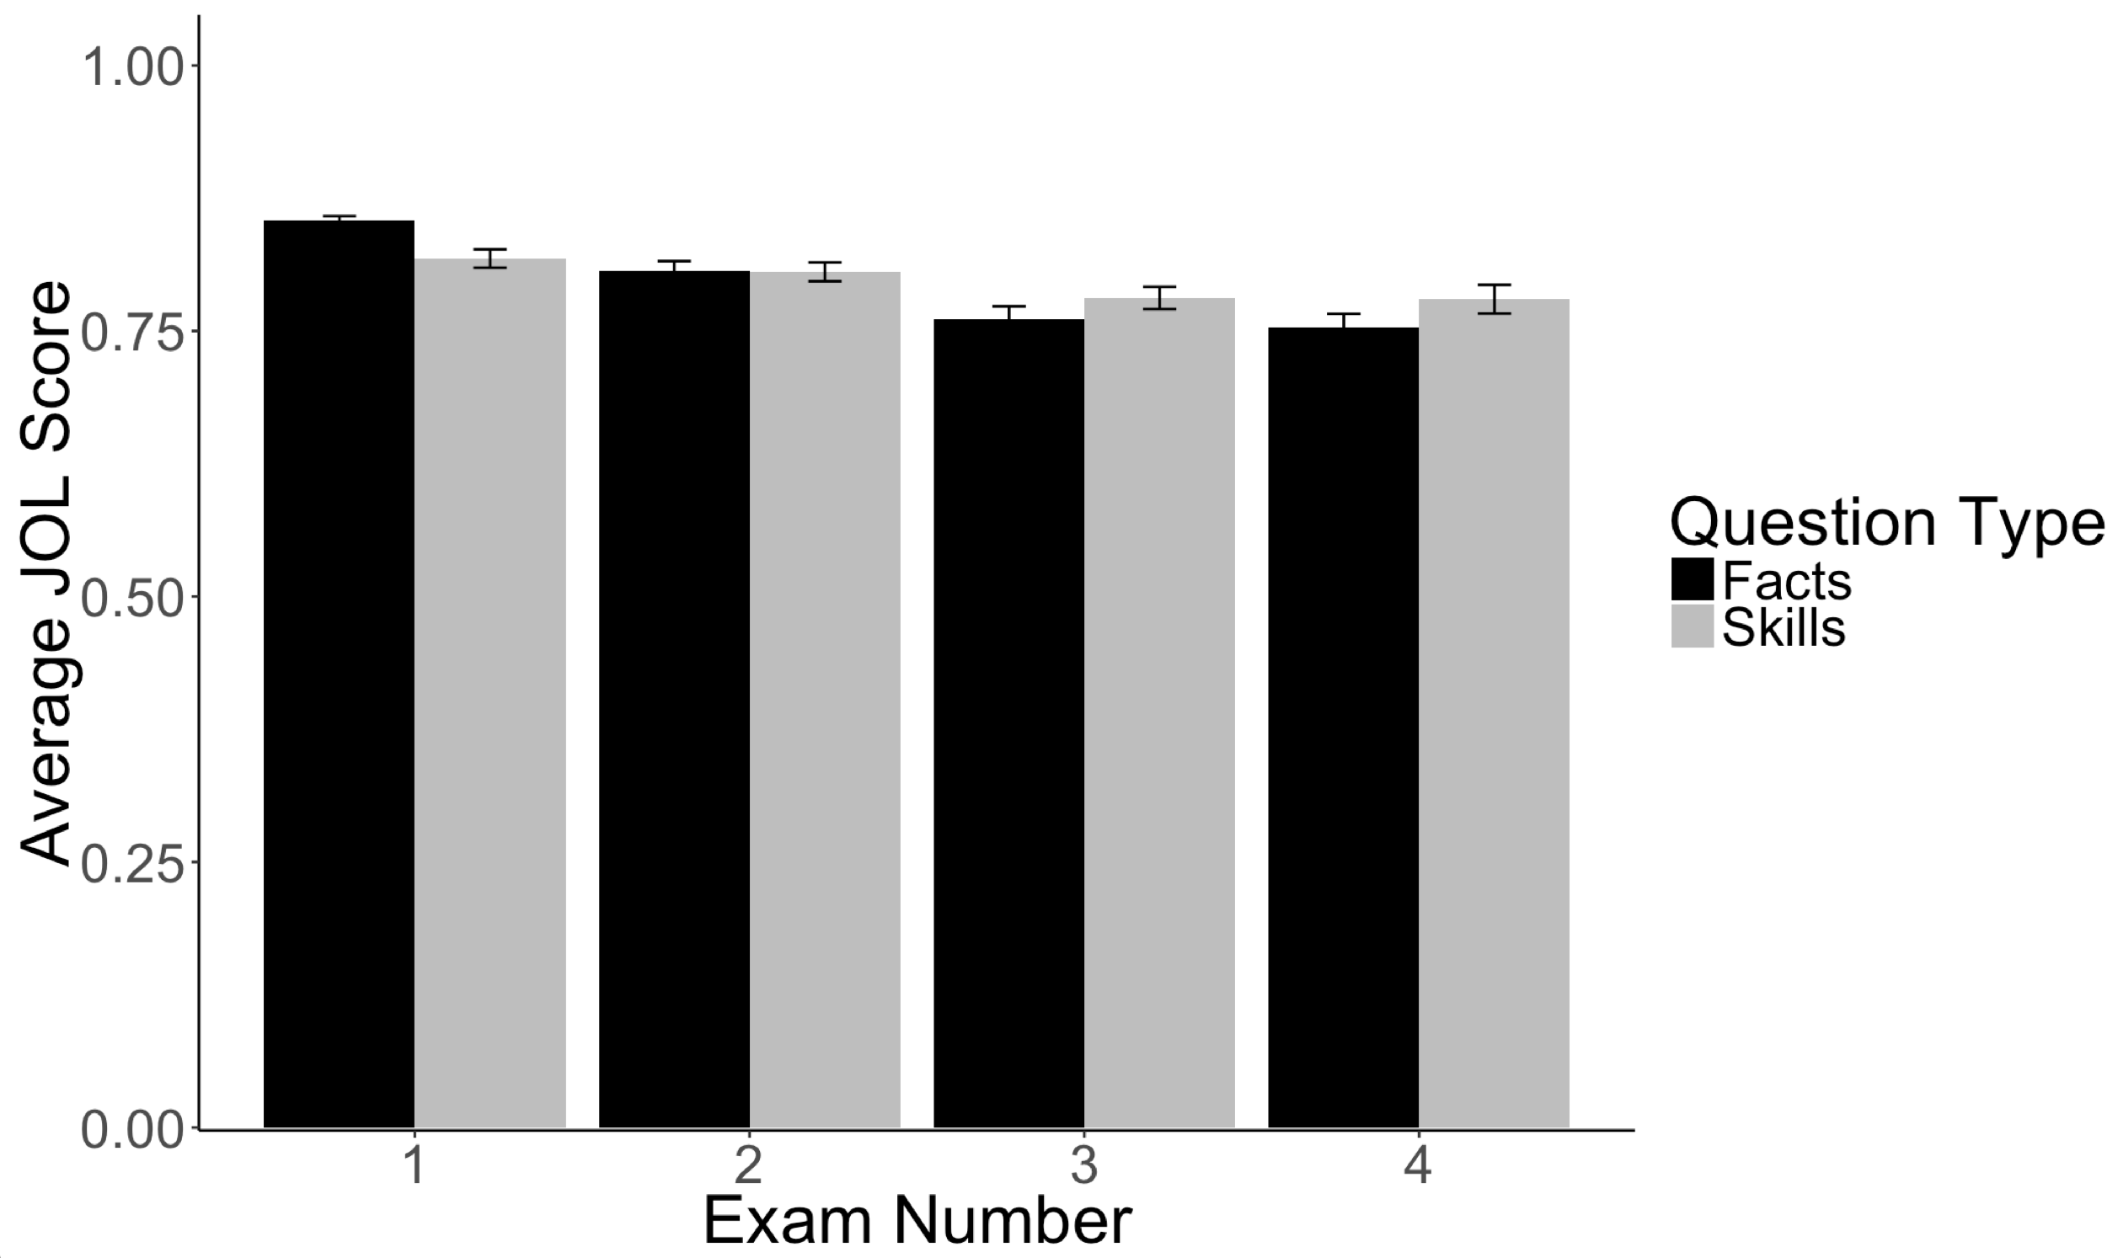
Moral Foundations of Political News Organizations
William E. Padfield and Erin M. Buchanan
Missouri State University
Abstract
The media ecosystem has grown, and political opinions have diverged such that there are competing conceptions of objective truth. Commentators often point to political biases in news coverage as a catalyst for this political divide. The Moral Foundations Dictionary (MFD) facilitates identification of ideological leanings in text through frequency of the occurrence of certain words. Through web scraping, the researchers extracted articles from popular news sources’ websites, calculated MFD word frequencies, and identified words’ respective valences. This process attempts to uncover news outlets’ positive or negative endorsements of certain moral dimensions concomitant with a particular ideology. The researchers gathered political articles from four sources. They were unable to reveal significant differences in moral or political endorsements, but they solidified the method for future research.
Results
Average Item Scores on Fact and Skills Based Questions
Main Effects
Predictor | b (SE) | t | p
GPA | 0.10 (0.04) | 2.57 | .01
Question Type | -0.07 (0.01) | -7.57 | < .001
Rating | 0.51 (0.04) | 12.34 | < .001
Expertise | 0.02 (0.05) | 0.50 | .62
Exam Time | -0.03 (0.005) | -7.14 | <.001
Concentration | 0.03 (0.06) | 0.53 | .60
Risks | -0.09 (0.08) | -1.13 | .27
Self Efficacy | 0.09 (0.04) | 2.26 | .03
Monitoring | 0.001 (0.06) | 0.02 | .98
Method
Sources
Political news articles from four U.S. sources - two preferred by liberals and two by conservatives (Mitchell, et al., 2014). The sources were The New York Times, NPR, Fox News, and Breitbart
Procedure
Body text of articles was scraped using the rvest library in R.
Using the tm and ngram packages, text was stemmed and processed to remove blanks, duplicates, punctuation, and capitalization
The same procedure was applied to the words in the Warriner, et al. dataset of affective ratings for 13,915 English lemmas.
Problem: MFD does not account for valence – it assumes any occurrence is positive endorsement. Also, it is not as
Article words were matched up with MFD counterparts, valence (pleasantness) value, and percent occurrence, which was multiplied by z-scored valence (to eliminate ambiguity regarding valence direction)
Analysis
A multilevel model controlling for correlated error of participant and item was used to analyze the data.
Independent variables included previous GPA (student aptitude), previous experience with statistical skills (expertise), JOL type (facts/skills), exam time, the SEMLI-S, and their interaction with JOL ratings.
Note. The analyses including the top variables were performed on the full dataset, while the SEMLI-S was analyzed on available values. Main effects change slightly in magnitude, but not direction for the smaller SEMLI-S subset.
Interactions – Simple Slopes
Average JOL Ratings
Group | b (SE) | t | p | pr
Low GPA | 0.86 (0.52) | 1.65 | .10 | .26
Average GPA | 0.77 (0.48) | 1.61 | .11 | .21
High GPA | 0.68 (0.44) | 2.86 | .12 | .24
Facts | 2.61 (0.74) | 3.52 | <.001 | .33
Skills | 1.08 (0.74) | 1.45 | .15 | .12
Exam 1 | 1.71 (0.82) | 2.09 | .04 | .12
Exam 2 | -4.36 (1.55) | -2.81 | <.01 | .23
Exam 3 | 2.41 (0.95) | 2.55 | .01 | .21
Exam 4 | -2.80 (1.30) | -2.15 | .03 | .35
Discussion
Several factors were related to JOLs and their accuracy in a classroom setting. This study attempted at looking at a few of those things; GPA, metacognitive awareness, and previous statistical experience, and further work should explore a diverse range of students and experiences to clarify the relationship between metacognition and statistical learning skills. Student aptitude, but not previous experience, showed a comparable JOL effect to previous studies (i.e. slope values in the .20 - .30 range). Students were more aligned in predicting their performance on facts questions, over skills questions. Course material (exam time) showed an interesting interaction on JOLs, as well as rated metacognitive skills.
Note. Interactions with expertise were not significant, along with the three-way interactions for any variables. The b values presented here are JOL rating to score. Because b values are difficult to interpret with all other variables, partial correlations are presented for comparison to traditional JOL gammas.
Metacognitive Interactions (see handout for table)
As concentration skills were rated higher, lower JOL-score simple slopes were found.
Higher rated risks decreased simple slopes with lower JOL-score correlations
Higher rated monitoring skills indicated higher JOL-rating simple slopes.
Contact: Dr. Erin M. Buchanan (erinbuchanan@missouristate.edu)
Thanks: Jessica Willis for her help with data entry and analysis.

